Slide 1

Best practice for storing and transforming presentations
© 2012 James Holgate
Vancouver BC Canada
Creative Commons Attribution Non Commercial Share Alike Canada License
Notes:
Hello. This is a discussion of best practice for storing and transforming presentations by James Holgate in Vancouver, BC, Canada.

Slide 2
What this is really about
A slide transformation project work flow should not include transforming presentation to images until as late as possible.
Ideally, transformations should take place in the cloud, not on the user's computer.
Notes:
A few days ago, I was asked to create some software that would convert the notes and images of a presentation to PNG images. I had questions. I thought that it would be best to do this sort of transformation in the cloud.

Slide 3
Principles (Criteria)
Open
Extensible
Compact
Cheap to transform
High fidelity
Notes:
Whenever we have to make decisions about something, it's a good idea to keep principles in mind. The principles help us to determine whether a certain course of action is good. The principles for this sort of software go something like this:
The software is open. It's extensible. It's compact. It's cheap to transform. It has high fidelity.

Slide 4
Open
Users should be able to retrieve their content
Content should be retained as fully as possible until it needs to be transformed to display (either visually or audibly)
If content of presentation is stored as pictures, then metadata (language, locale, keywords etc.) and text are lost.
Notes:
Let's talk about openness. User should be able to retrieve their content. The content should be retained as fully as possible until it needs to be transformed to display format. The display format may be visual or audible. If the content of presentation is simply stored pictures, then a lot of information is lost! For example, the language of the text, the locale, and keywords are all lost. It is better to retain the information in the document as long as possible.

Slide 5
Extensible
We can't predict fully how users will want to use their data
We shouldn't lock them in early to a specific output appearance
How would blind people interact? People with limited sight? Deaf people? People with limited mobility?
Notes:
The second key principle is extensibility. We can't really say how users want to use their content. We don't know exactly how ultimately we will want to use the data. For these reasons, it's unwise to lock in the specific format of the output appearance early. How would blind people interact with the software? Or people with just limited site? Deaf people? People with limited mobility? There aren't easy answers, but time and experience will tell.

Slide 6
Compact
Text is stored with fewer bytes than images
Many presentations are primarily text based
OpenOffice.org, LibreOffice and Excel include the ability to create vector based graphics.
Vector based graphics are almost always more compact than bitmap images
Notes:
One of the unique value propositions of this product is that it makes clear communications possible in low bandwidth situations. Therefore, it is important that the document format be as compact as possible. The project as it's currently stands uses images rather than text. Many presentations are primarily text dates and would be more efficiently percentage if they retained your text quality. OpenOffice.org Impress and other presentation software includes the ability to create vector-based graphics, which are mathematical descriptions of lines and fills. Vector-based graphics are almost always more compact than bitmap images. In the current deployment, images are always saved as bitmaps, so there's almost no chance that images will be presented in the most compact manner possible.

Slide 7
Cheap to transform
Since the software is free, what do we mean by cheap?
Cheap!
Notes:
This slide says "cheap to transform". Since software is free what are we mean by cheap?

Slide 8
Cheap to transform
Since the software is free, what do we mean by cheap?
Cheap means fast, reliable and simple
If you use LibreOffice scripting to transform, you need a lot of time and complexity
GhostScript (Free) can transform PDF files to a series of images quickly, reliably and simply on a server.
Notes:
To me, cheap means fast, reliable and simple. A cheap solution uses the least amount of computer resources, and it uses the predictable and direct manner. Using an instance of a full office suite for scripting the transformation of presentations to images is complex, slow, and may break down with system updates or new versions of the presentation software. By contrast, Ghostscript is a tool that is specifically designed to create image files in a wide variety of formats and sizes.

Slide 9

High fidelity
When you save images as bitmaps, you only can use the image up to the original resolution or it looks like garbage.
Enlarge
Vector image scaled
Bitmap image scaled
Notes:
High fidelity. When you save images as bitmaps, you're committing to a maximum resolution. Images often look blurry or pixelated when are shown at the wrong size. Presentation software and PDF format can retain high fidelity vector images until the point at which you know the exact resolution of the user's display.

Slide 10
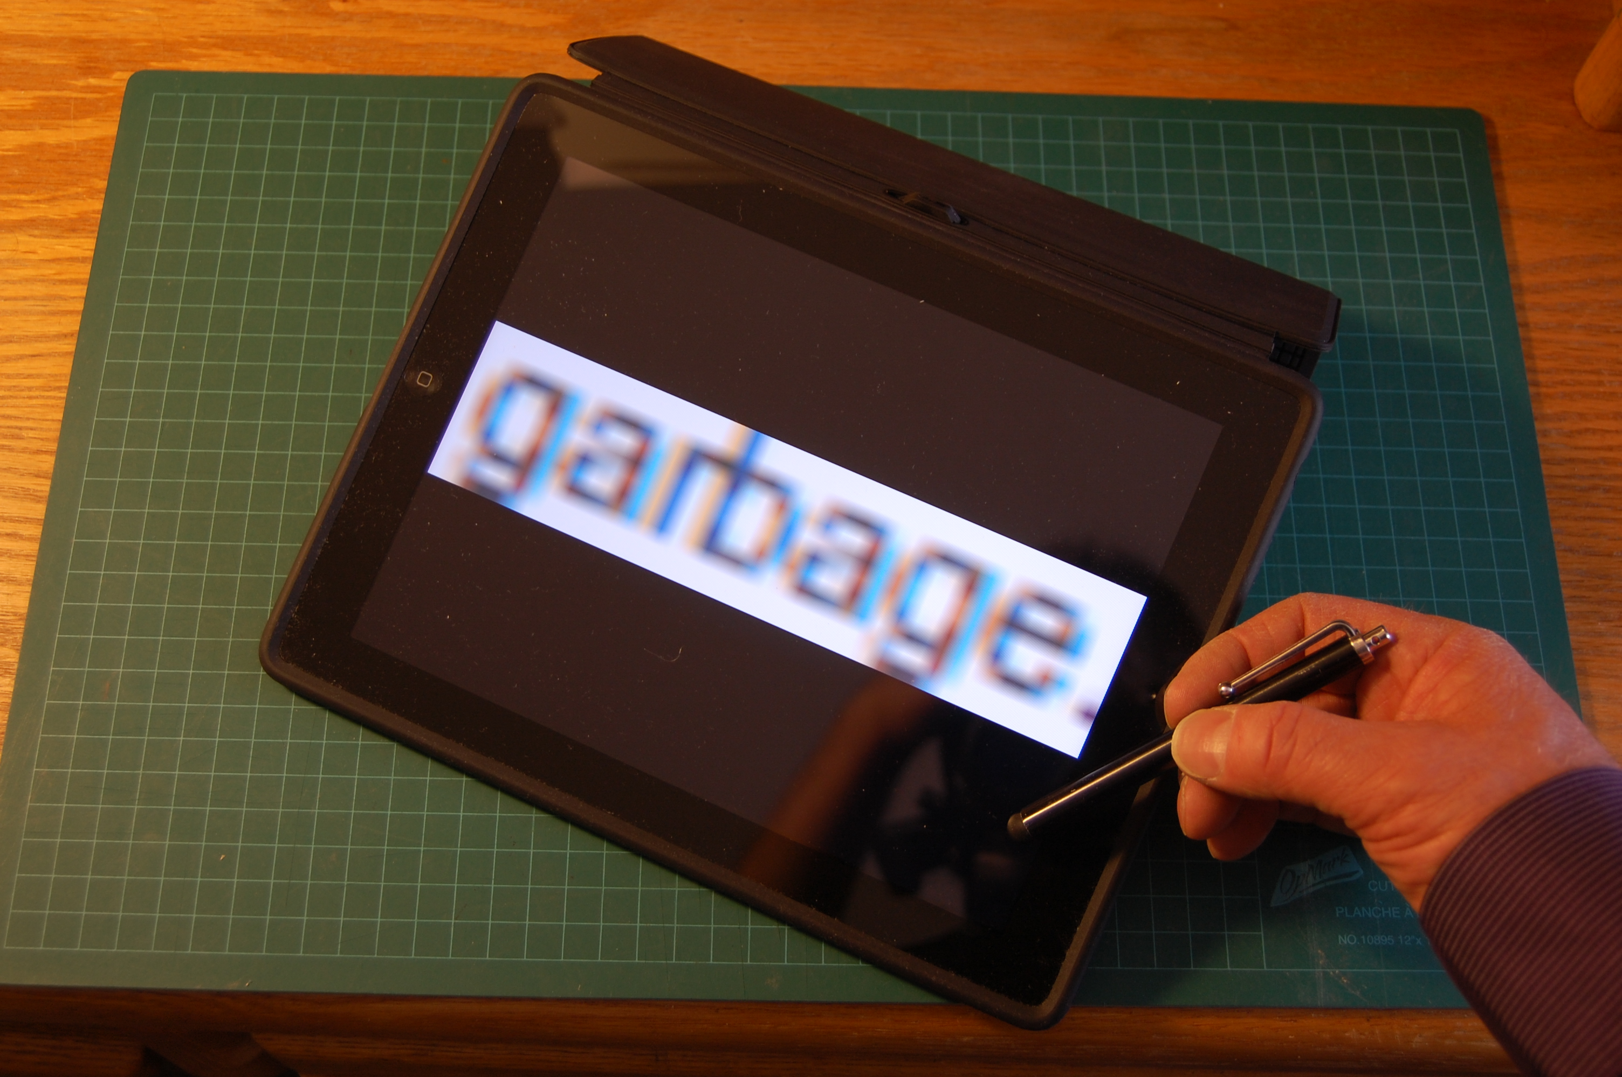
Low fidelity + high expectations = ?
Notes:
Users don't have time for garbage. If an application doesn't look great and work great, it will go straight to the rubbish bin.

Slide 11
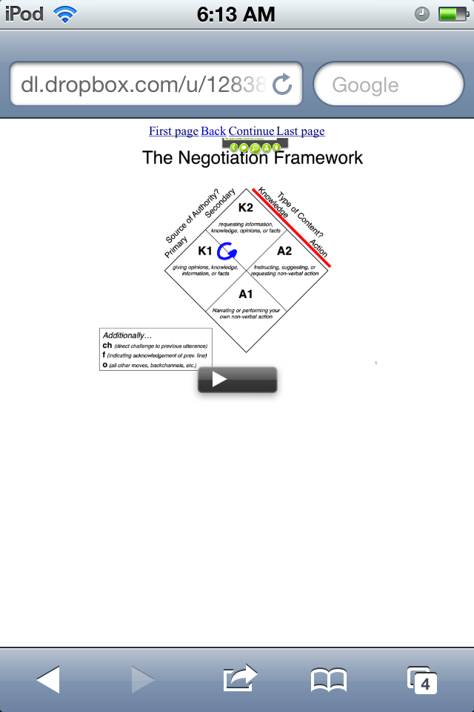
How does it scale?

Slide 12
What to do?
Sending a presentation to the cloud in OpenDocument Presentation (ODP) format should continue to be supported.
Creating JPG or PNG image files on the client's computer will likely be error prone and expensive to maintain over different versions of operating systems and of the presentation generating program.
Notes:
So, where do we go now? Well, I think the idea of sending a presentation directly to the cloud the e-mail or via a posting mechanism is a essentially a good one and should continue to be supported. However, a program on the user's computer that creates JPEG or PNG image files is likely to be error-prone and expensive to maintain over different versions of operating systems and of the presentation software. I recommend that the end users' computer do as little as possible.

Slide 13
Server service
I surmise that the instance of LibreOffice on the server uses a script to convert each slide to an image.
It might be more efficient to just save the document as a PDF file and use GhostScript to make a series of PNG images of an appropriate resolution on demand if required.
Notes:
On the server side of the equation, I understand that there's an instance of leave the office on the server that's used by a script to convert each slide to an image. This is wasteful. It's much more efficient just to save the document as a PDF file and use Ghostscript to make a series of PNG images. You could even have the images stored as a PDF, and then converted to PNG images of an appropriate resolution as required.

Slide 14
How to use GhostScript
gs -dSAFER -dBATCH -dNOPAUSE -sDEVICE=png16m -r150 -dTextAlphaBits=4 \
-sOutputFile='output-%00d.png' input.pdf
http://pages.cs.wisc.edu/~ghost/doc/AFPL/8.00/Use.htm
Notes:
All the complex code currently used to process images could be replaced by a single Ghostscript command.

Slide 15
Future
Possibly, the client on the user side could create an easy to process “slidespeech” zip container containing at minimum:
Notes:
Using open document format presentation is a good solution for the present. In the future, it might be better to send a specially formatted speech file. This would take the form of a zip file containing a PDF and some XML files that describe the contents and include the speakers' notes.

Slide 16
Future 2
It would be fairly easy to for a client to display the page at the correct resolution on the receiving device since PDF display is ubiquitous on desktop and smart mobile devices.
The slide-notes.xml file would simply contain a list of the slide notes – which could be displayed as a tooltip or spoken aloud.
Notes:
Using PDF is a really good solution because you don't predetermine the resolution of the display device. If the display device was not able to display a PDF file, it would be reasonably simple with Ghostscript to serve up an image with the correct resolution. In the zip file the file name slide notes XML that simply contain a list of the slide notes which can be displayed as a tooltip or spoken aloud. Possibly, the presentation notes XML file could have a language designation, so one presentation could support several different languages.

Slide 17
Principles (Criteria)
Open
Extensible
Compact
Cheap to transform
High fidelity
Notes:
And so, we come back to the principles and criteria slide, which are no more and no less than a few ideas I came up out of nowhere in particular. Please evaluate the proposals given in this presentation by the principles that are important to you.

Slide 18
Core mission
Create world class, easy-to-use authoring systems
Display the content with the highest standards of usability and aesthetic beauty
Support a wide variety of content for educational, recreational, commercial, health, safety and law enforcement use.
Notes:
You might want to take a couple of minutes to think about what the core mission of this project is - something you can use to decide if you are working on things that are important and that you can use to better communicate your vision. What I came up with are only starting points for a discussion. It’s an important discussion.
Thank you for taking time to view and consider this presentation. This presentation was written and illustrated by Jim Holgate in Vancouver, British Columbia, Canada on May 16, 2012.

